Slide 1
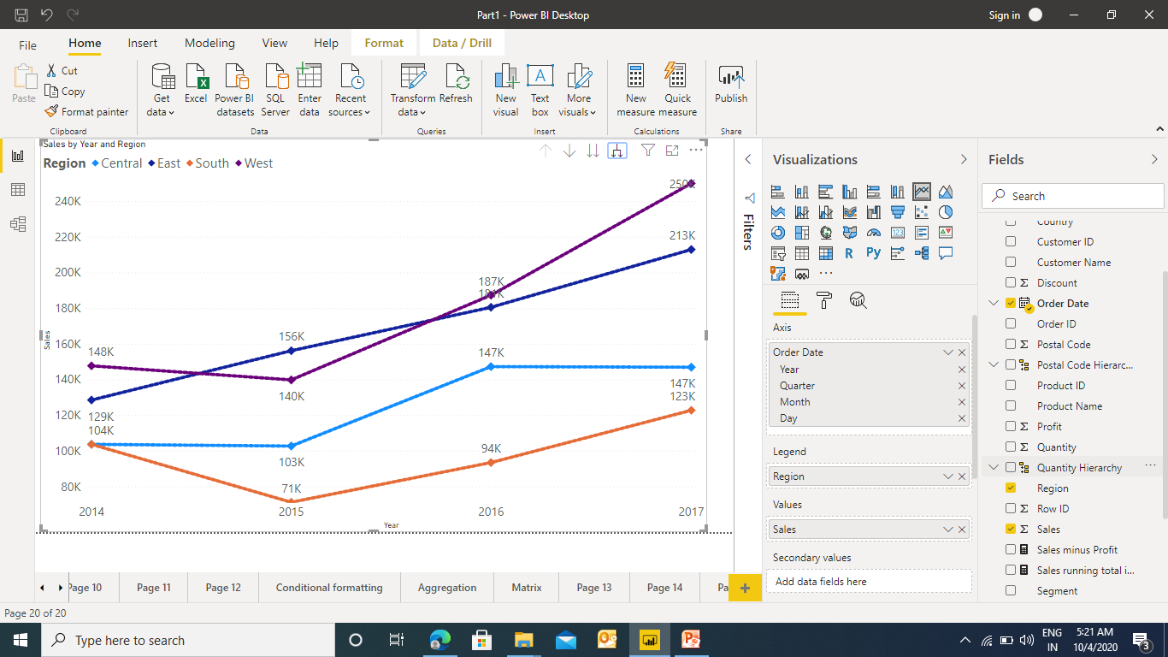

Line Chart in Power BI
To create a line chart we need to have a date field

Slide 2
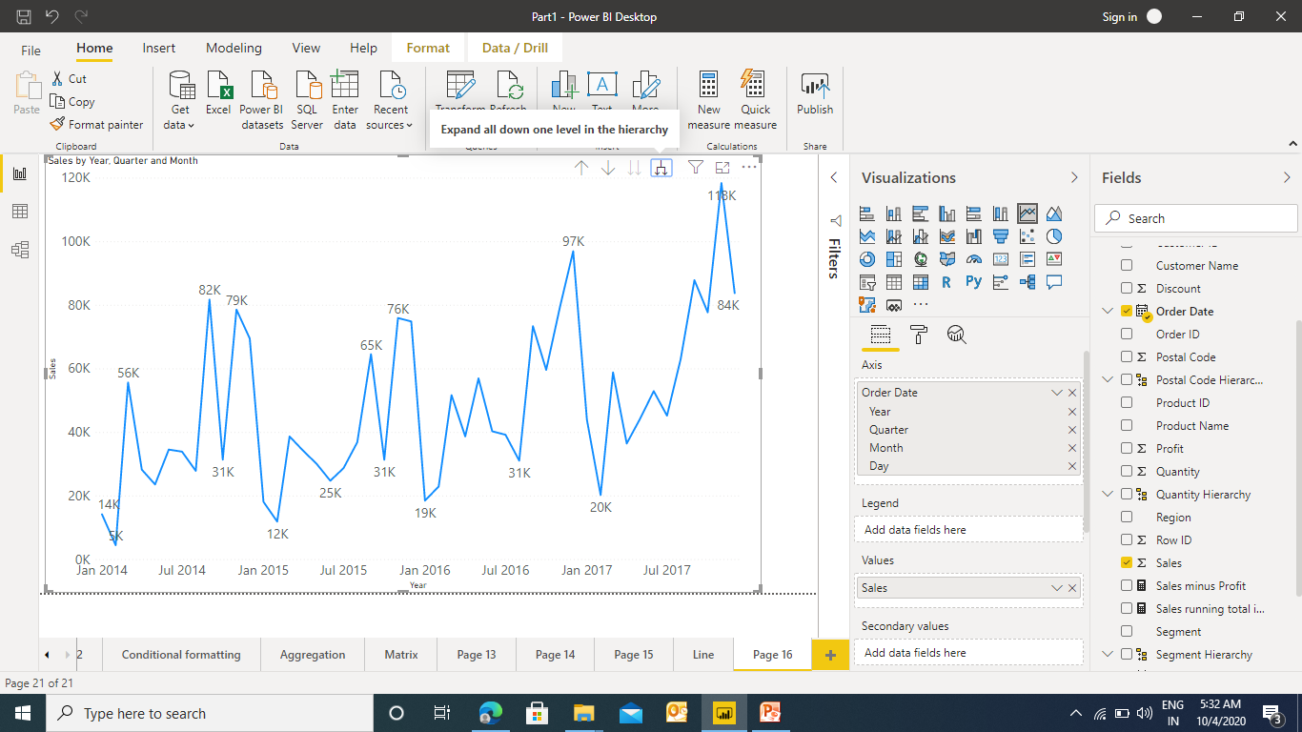
Line Chart in Power BI
As the date field has been used in Line Chart it also gives the feature of Auto Hierarchy

Slide 3
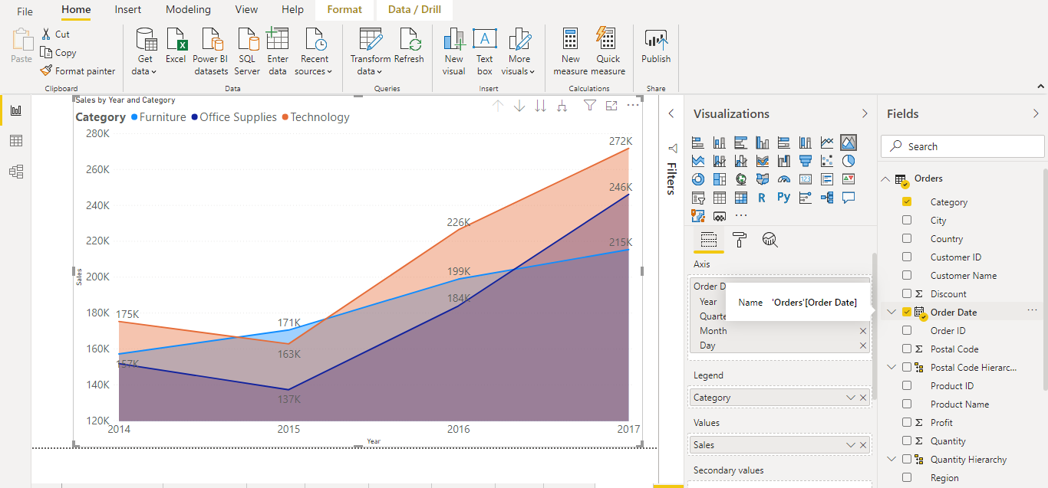
Area Chart in Power BI
Area Chart is the enhancement of line chart where the area below the line is filed

Slide 4
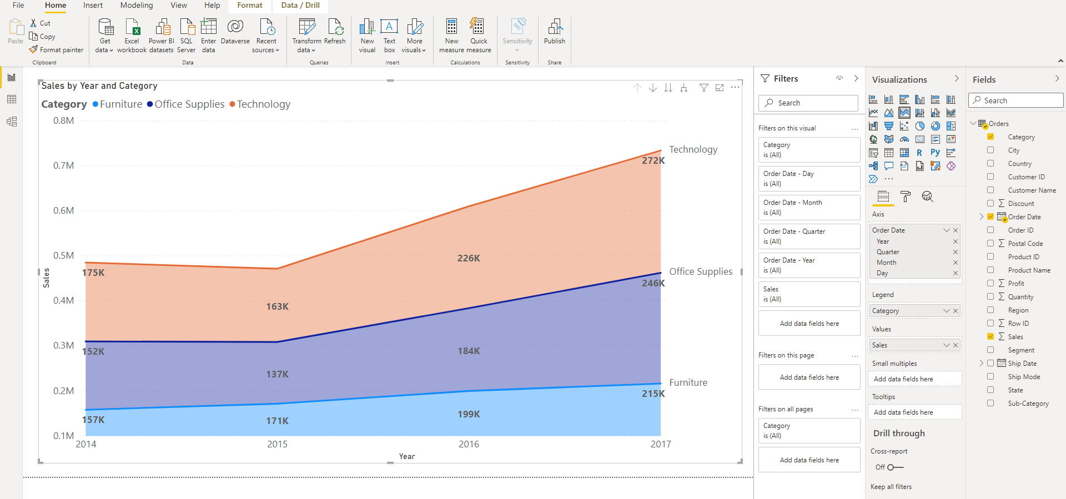
Stacked Area Chart in Power BI
Area Chart is the enhancement of line chart where the area below the line is filed

Slide 5
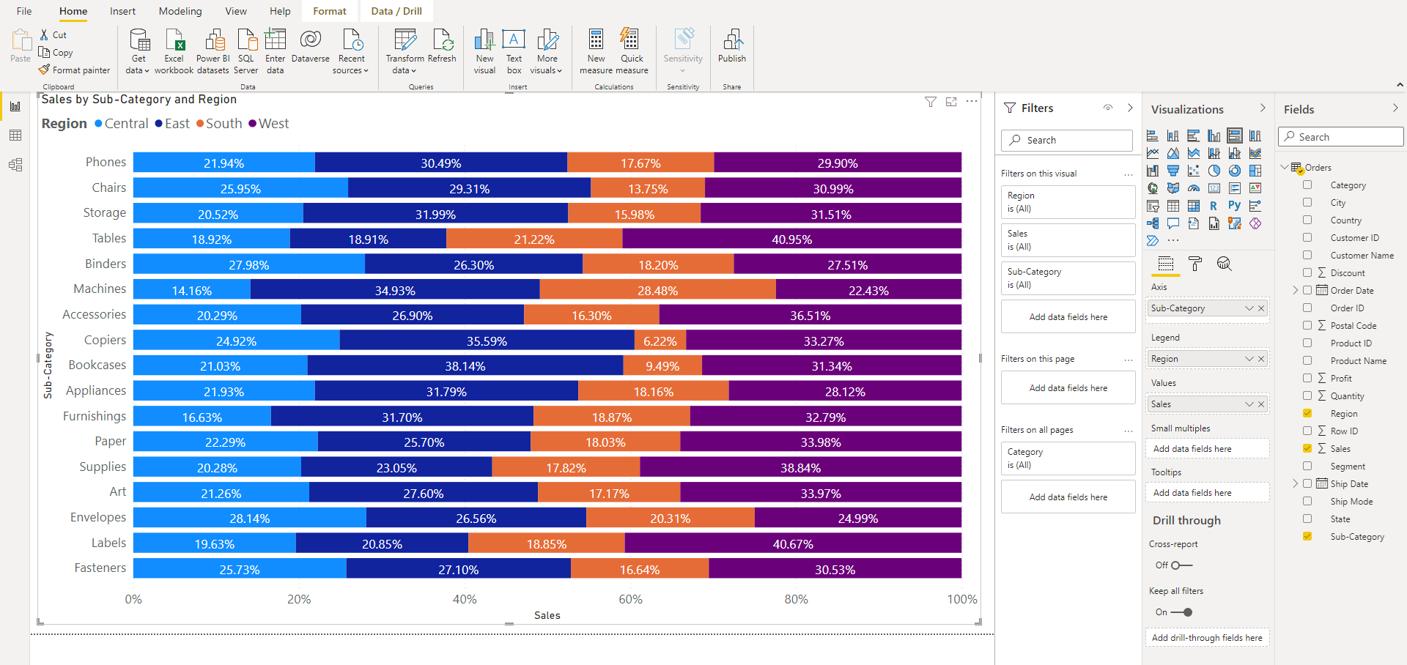
Basic Charts in Power BI –100% Stacked Bar Chart

Slide 6
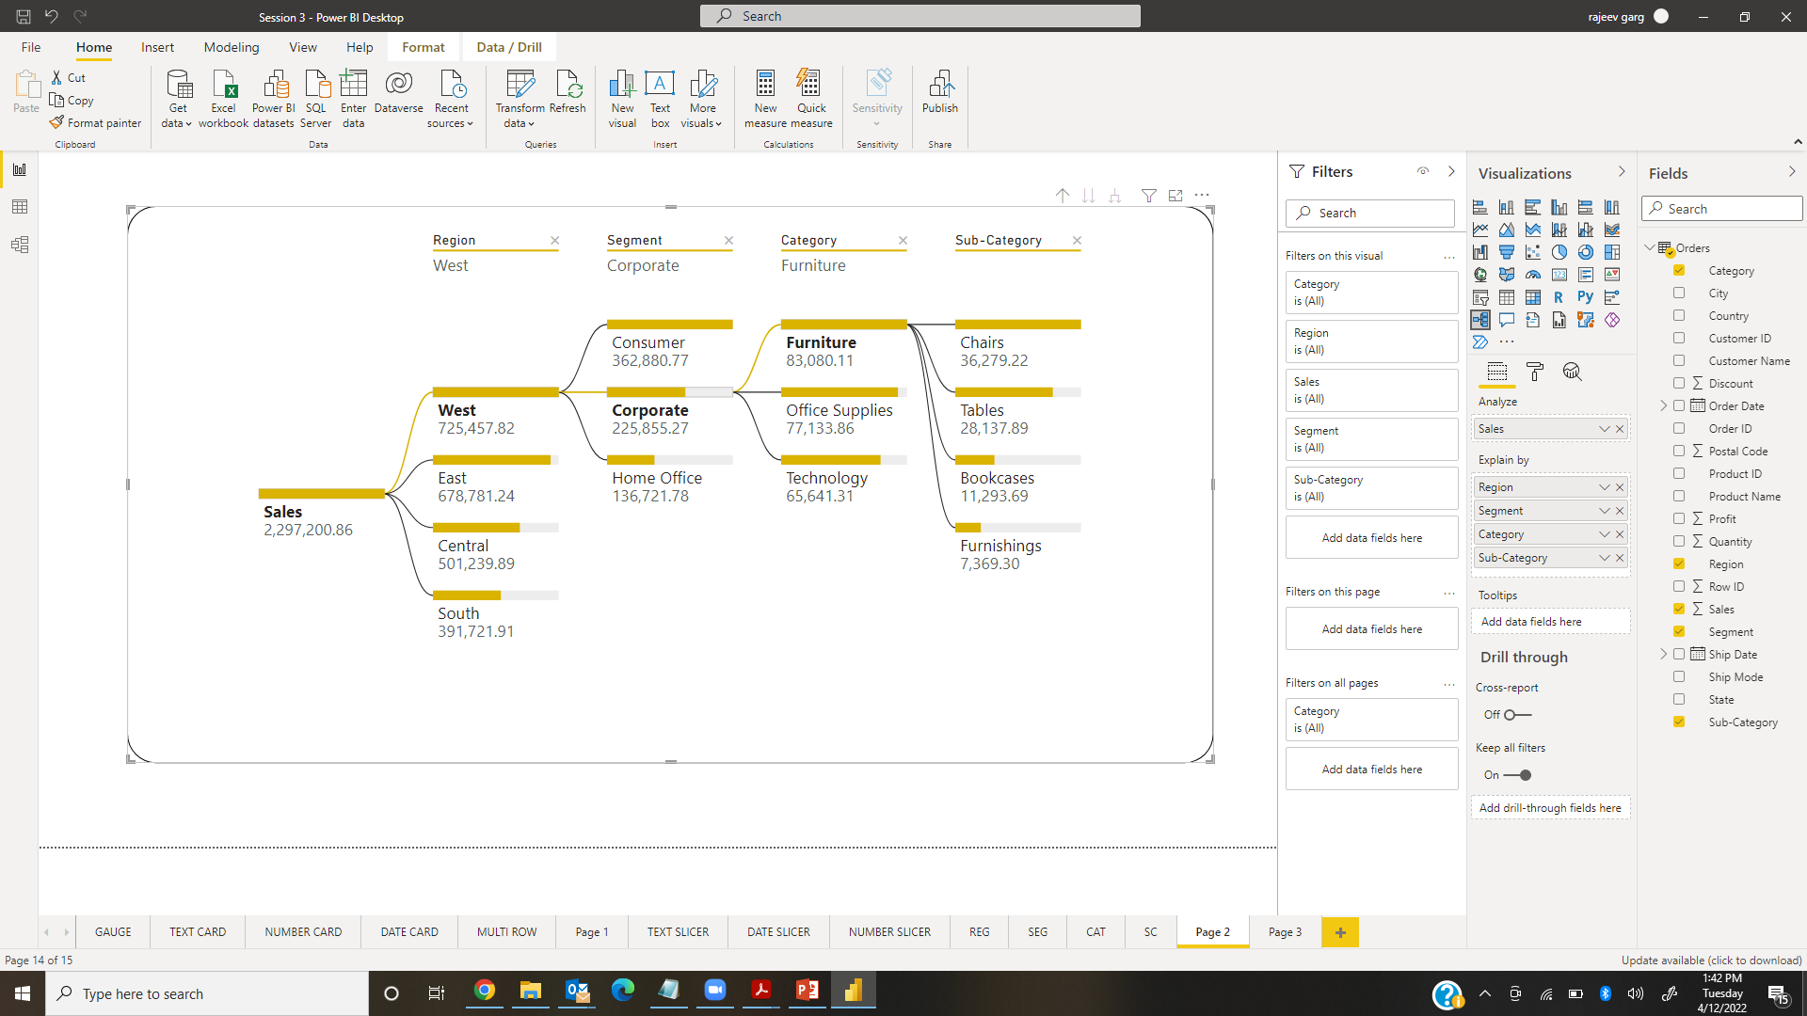
Basic Charts in Power BI – Decomposition Tree

Slide 7
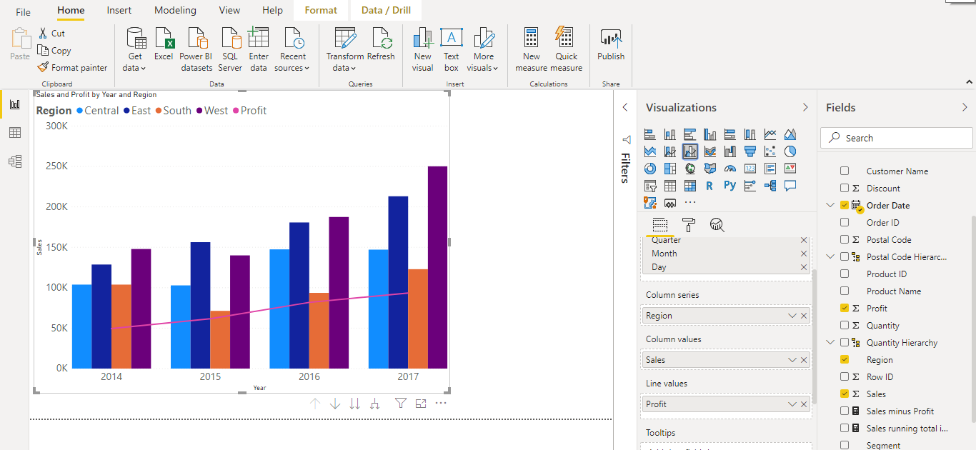
Combo Chart in Power BI
Combo Chart is a combination of Line & Column chart. Also be considers as dual axis chart. It is used to compare the two measures . Line & Clustered Column

Slide 8
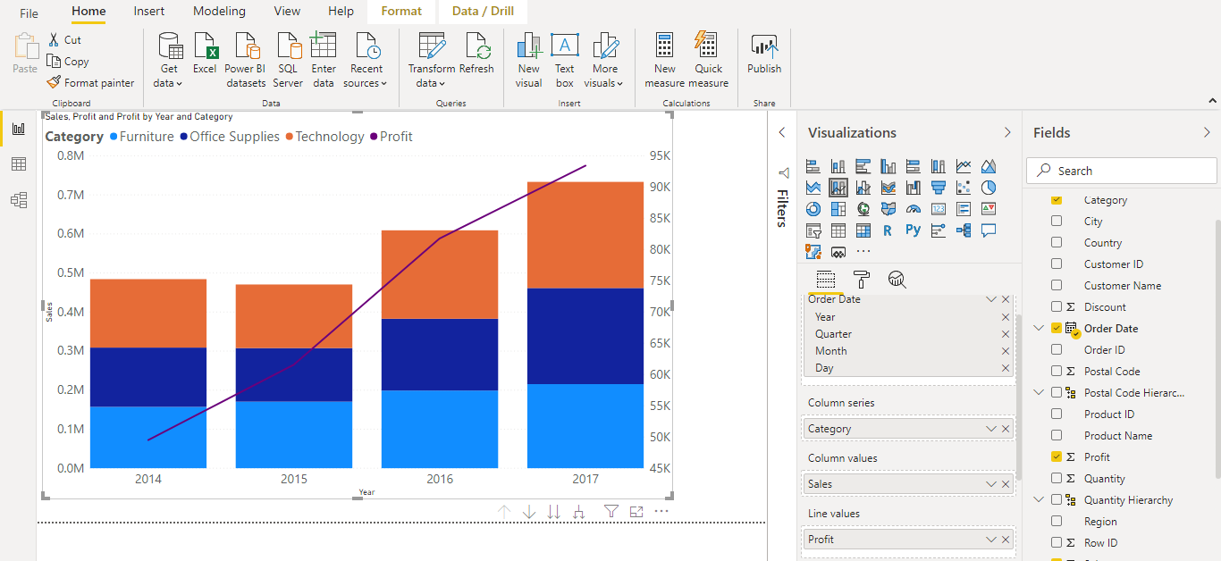
Combo Chart in Power BI
Combo Chart is a combination of Line & Column chart. Also be considers as dual axis chart. It is used to compare the two measures . Line & Stacked column

Slide 9
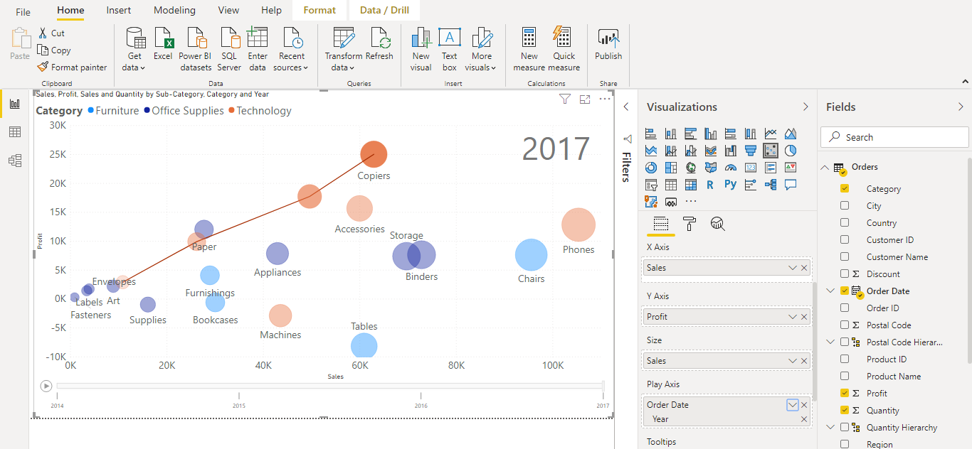
Scatter Chart in Power BI
Scatter chart is used to compare the two numeric files (measures) . It is the only default animation chart in Power BI.

Slide 10
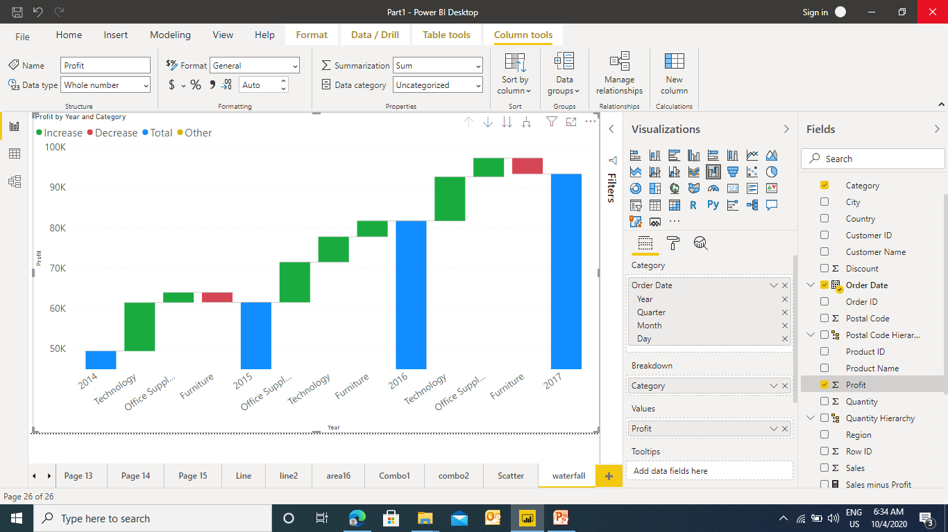
Waterfall Chart in Power BI
Waterfall chart is useful when we want to display the trend

Slide 11
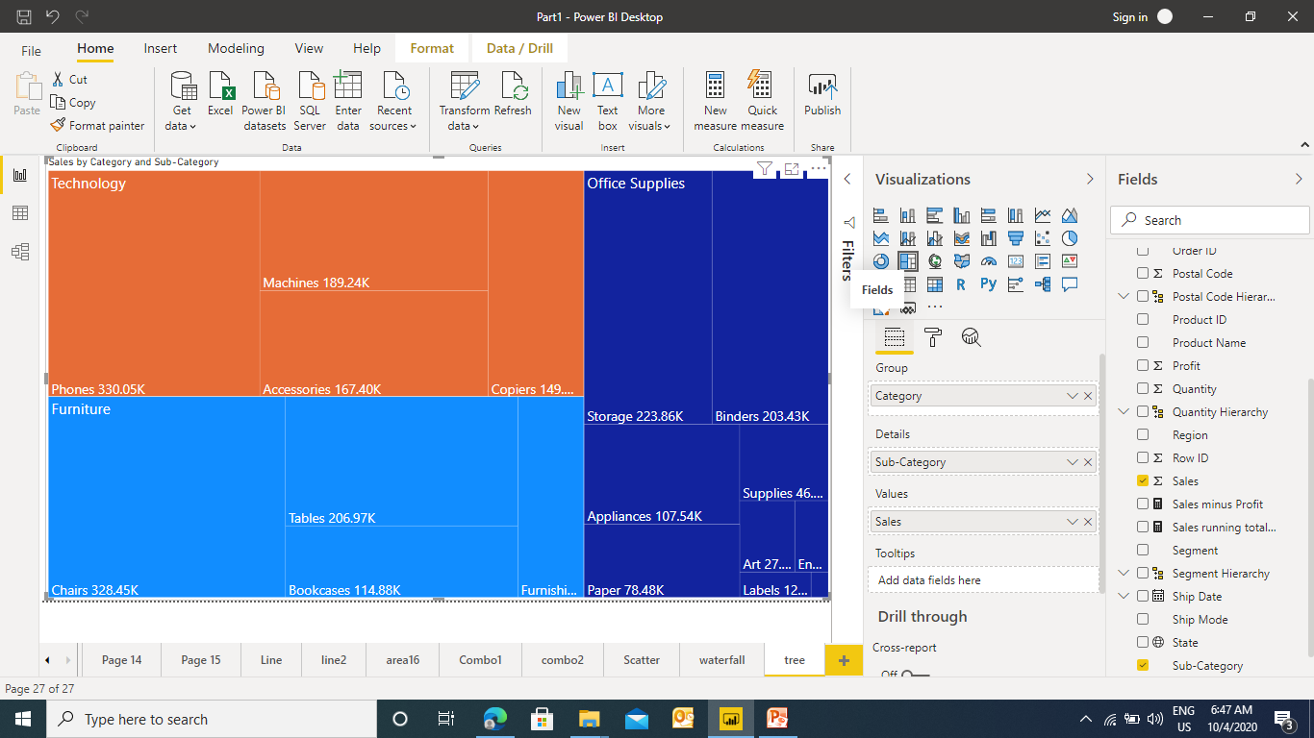
Tree Map in Power BI
Tree map displays the data in a form of boxes / rectangles of various size. These are useful to display a parent child relationship in the fields.

Slide 12
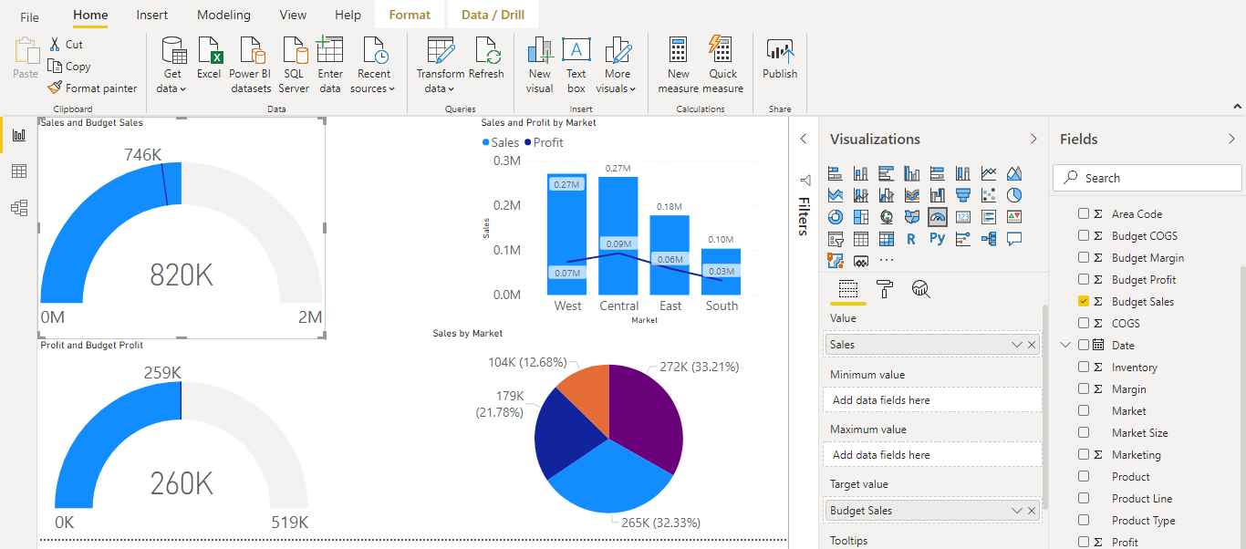
Gauge Chart in Power BI
A gauge chart is a half circle and shows a single value that measures progress toward a goal . The line (or needle) represents the goal or target value and the filled circle represents the actual value.

Slide 13
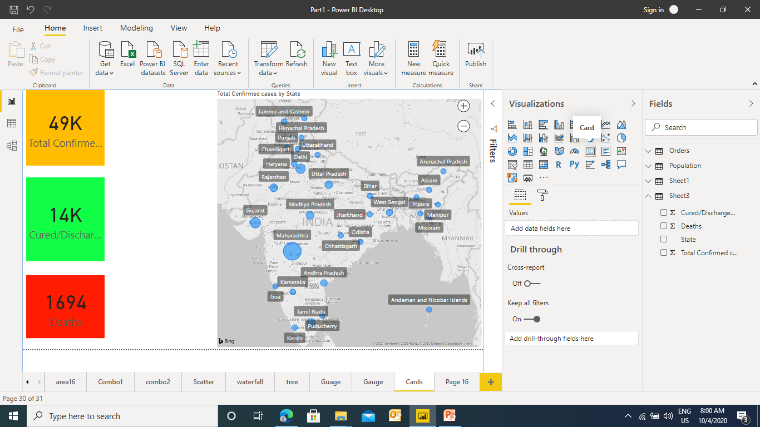
Cards in Power BI
Cards are the indicator which gives some value could be Number, Text Date .
Ex1 : Card with Numbers

Slide 14
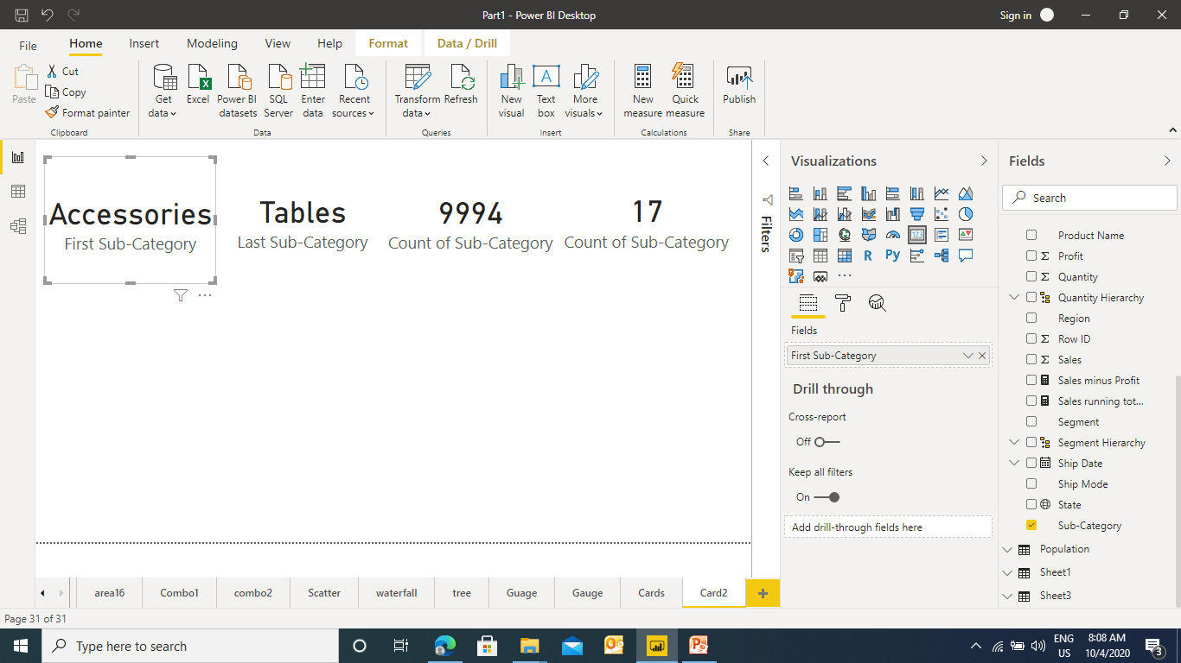
Cards in Power BI
Ex2 : Card with Text

Slide 15
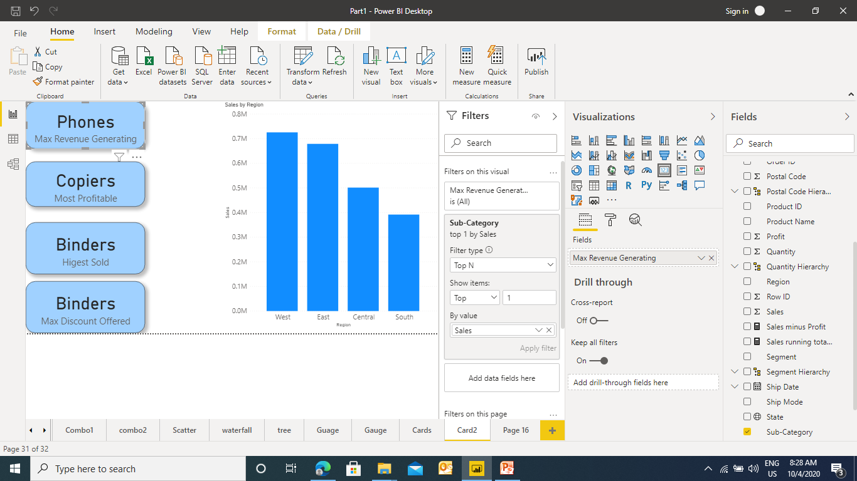
Cards in Power BI
Ex3 : Card with Dynamic Text

Slide 16
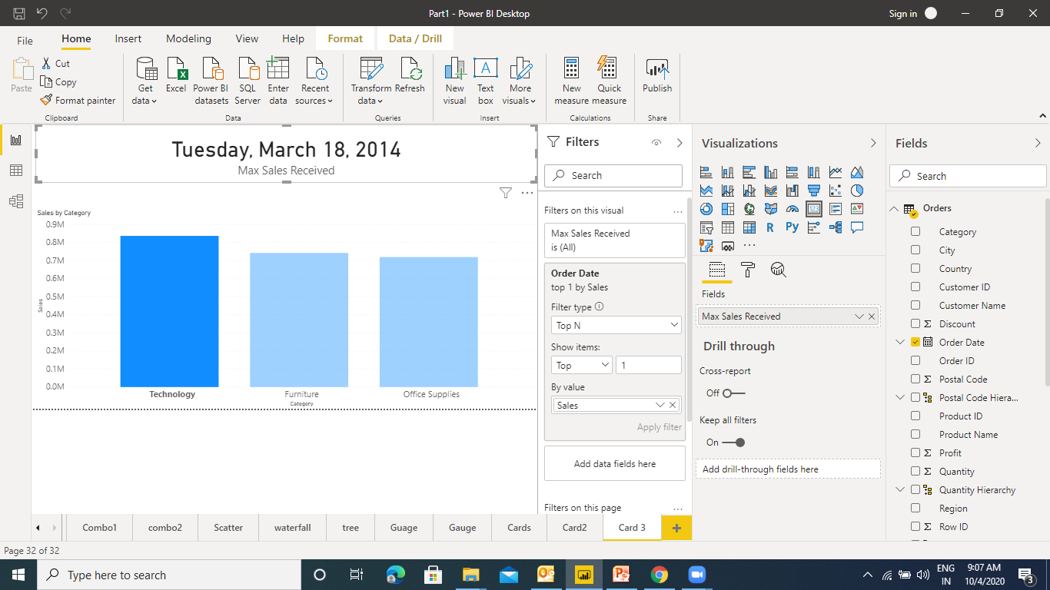
Cards in Power BI
Ex4 : Card with Dates

Slide 17
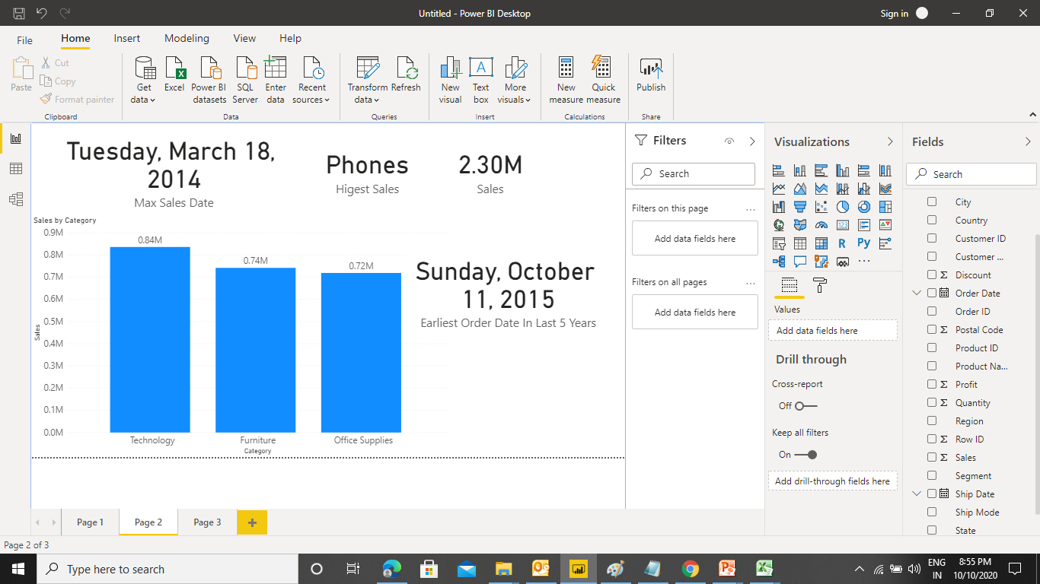
Cards in Power BI
Ex5 : Card with Relative Dates

Slide 18
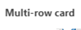
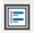
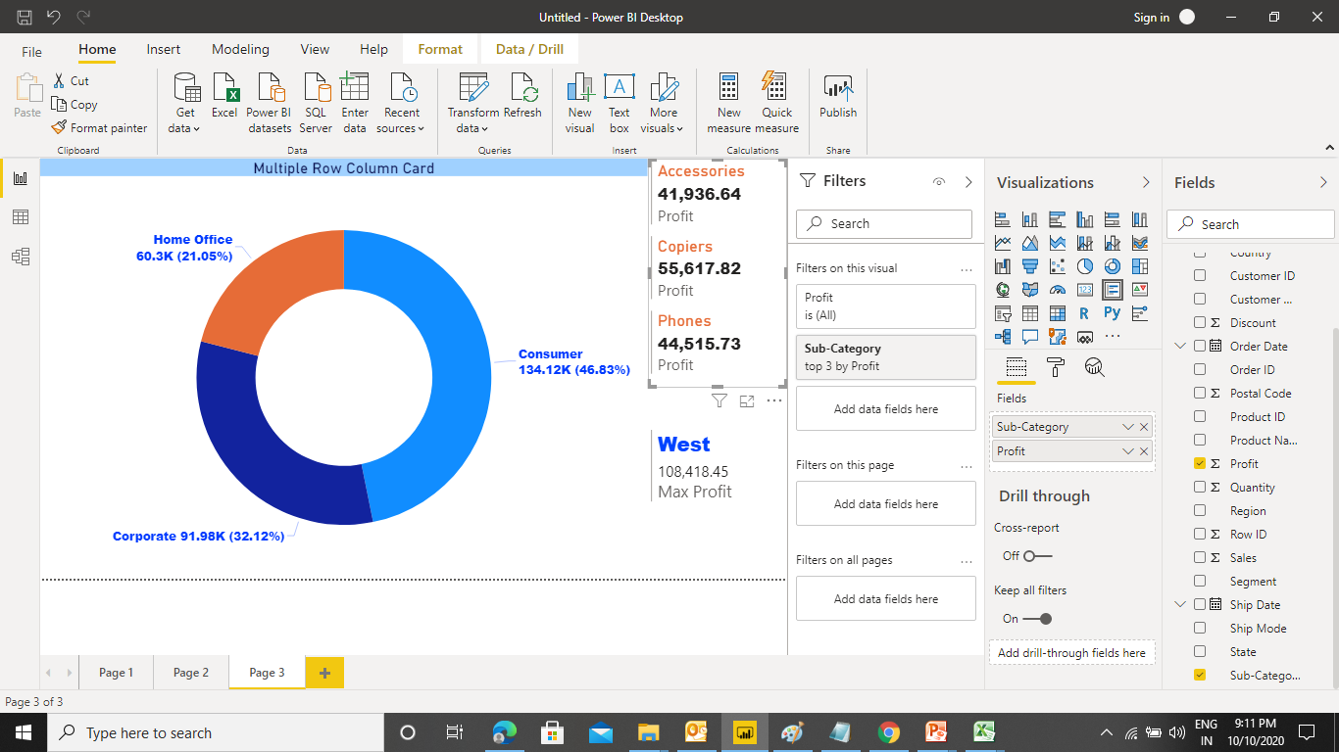
Cards in Power BI
Ex5 : Multiple Row & Column Card

Slide 19
Filters in Power BI
There are different types of filters in Power BI:
Filters on this Visual
Filters on this page
Filters on all pages
Drill Down

Slide 20
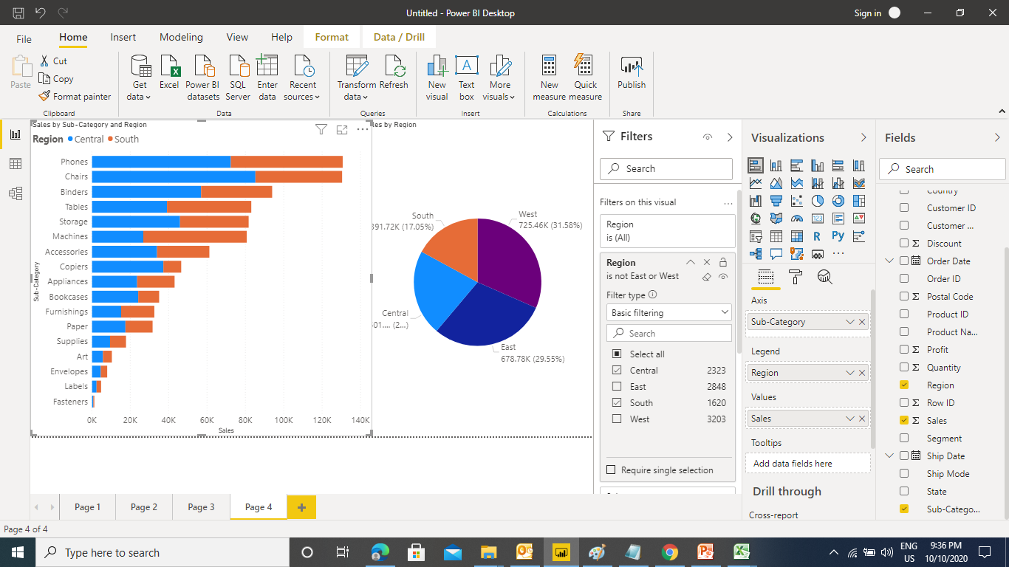
Filters in Power BI
Filters on this Visual – This type of filter will only effect the chart on which it has been applied.

Slide 21
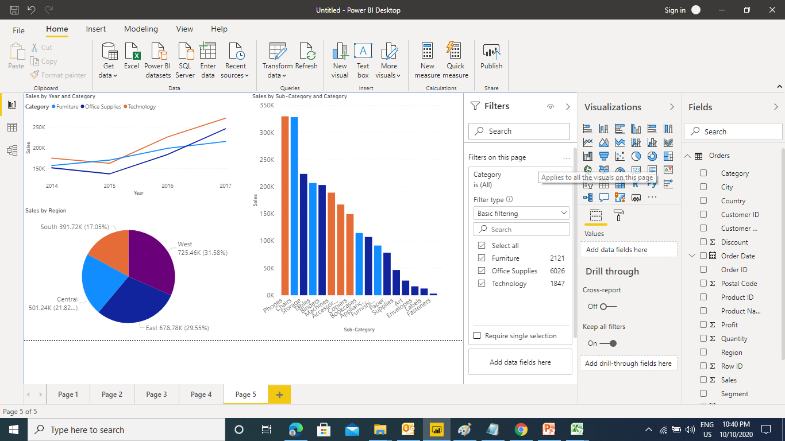
Filters in Power BI
Filters on this Page – This type of filter will effect all the chart on the page

Slide 22
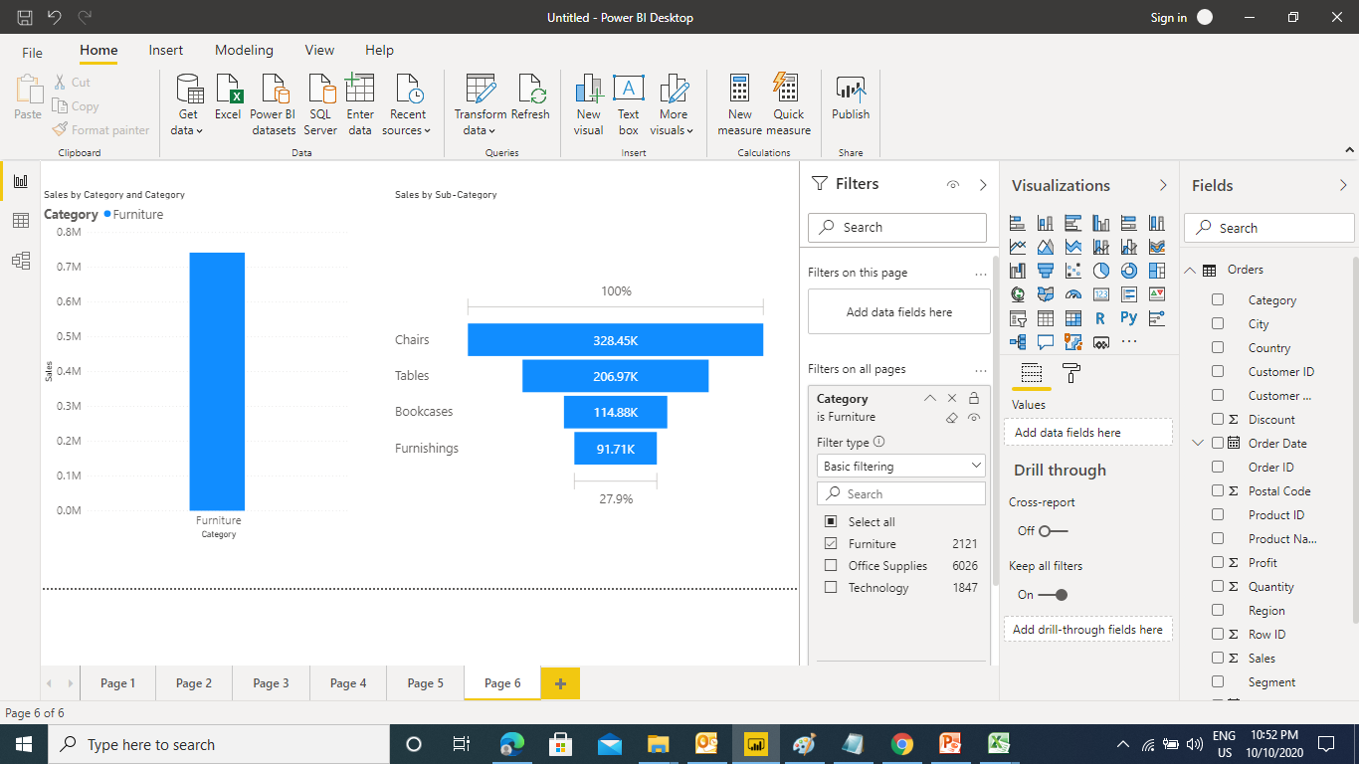
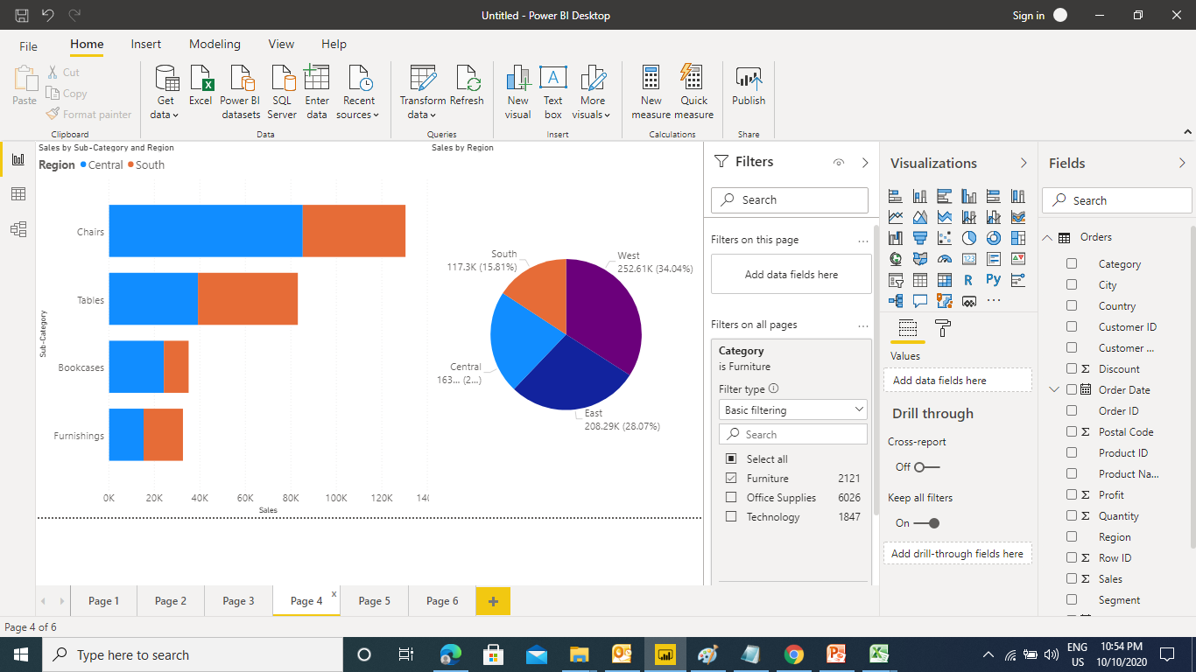
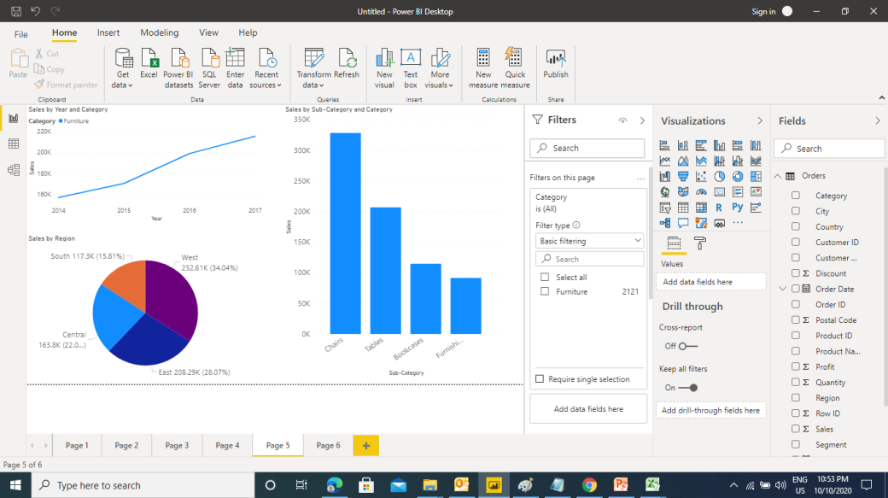
Filters in Power BI
Filters on All Pages – This type of filter will effect charts on all the page

Slide 23
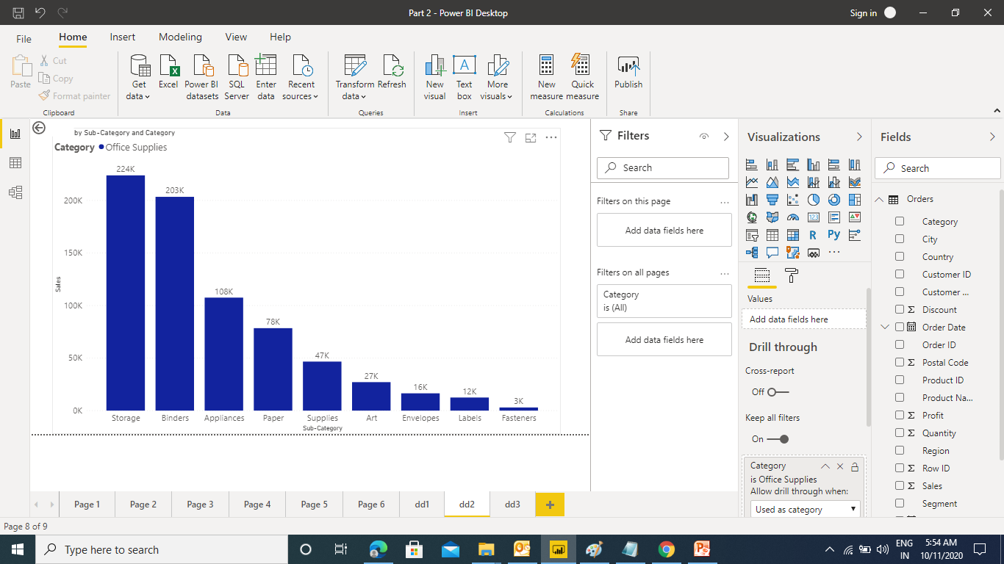
Drill through in Power BI
Drill through is used to navigate to different pages to drill down the information

Slide 24
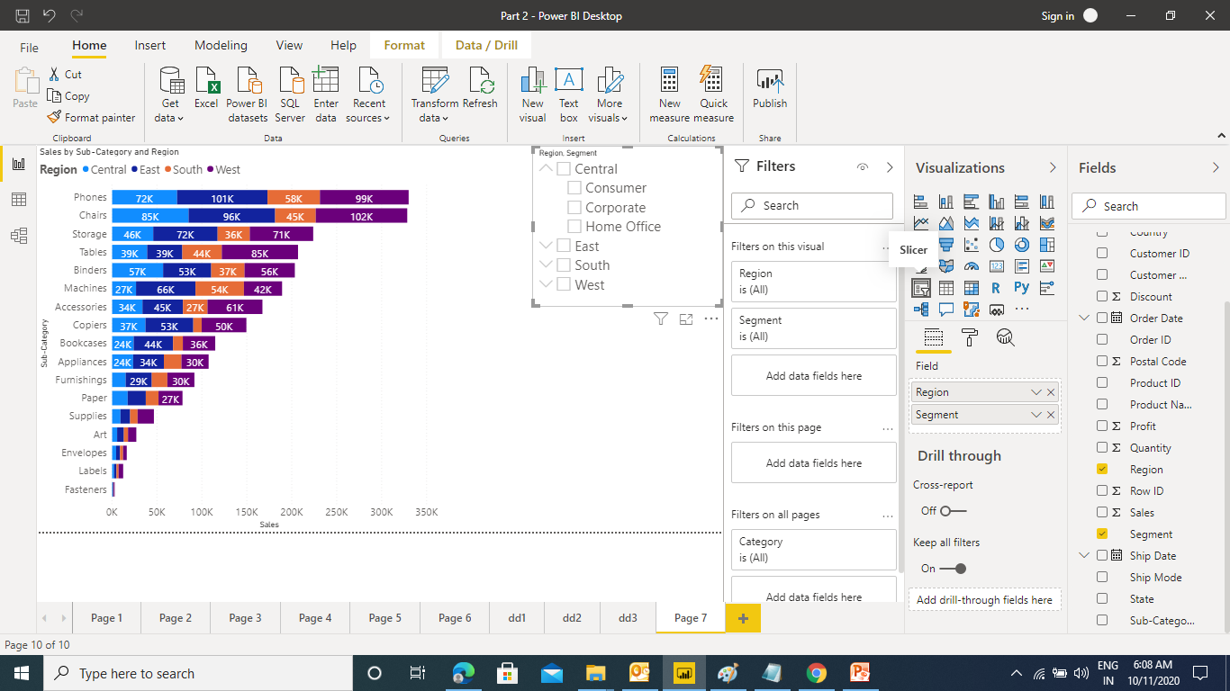
Slicers in Power BI
Slicers are the interactive filters - Text Slicers

Slide 25
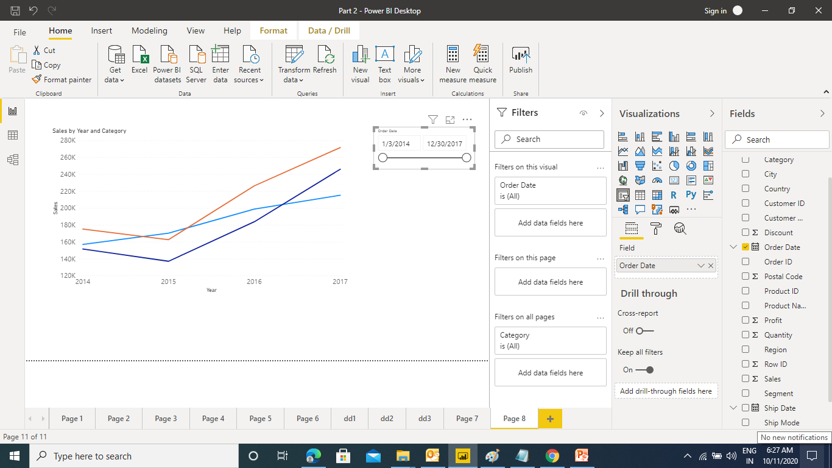
Slicers in Power BI
Slicers are the interactive filters - Date Slicers

Slide 26
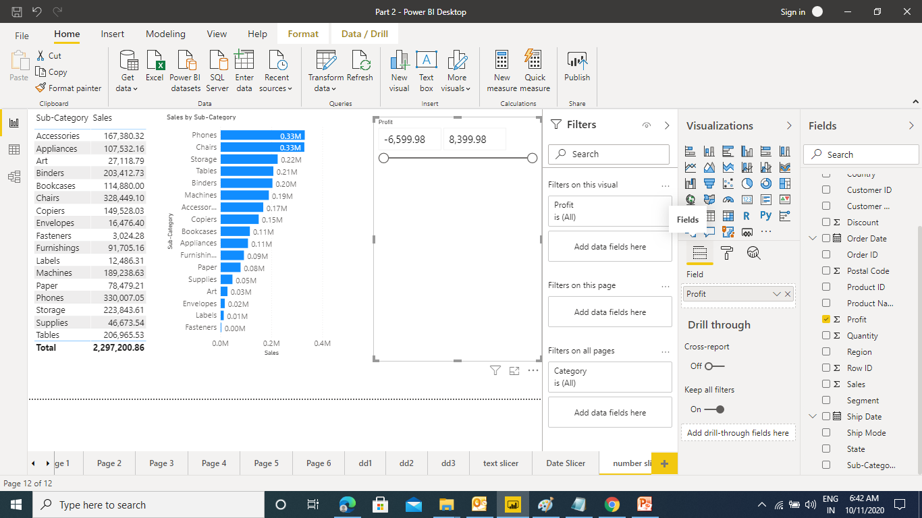
Slicers in Power BI
Slicers are the interactive filters - Numeric Slicers

Slide 27
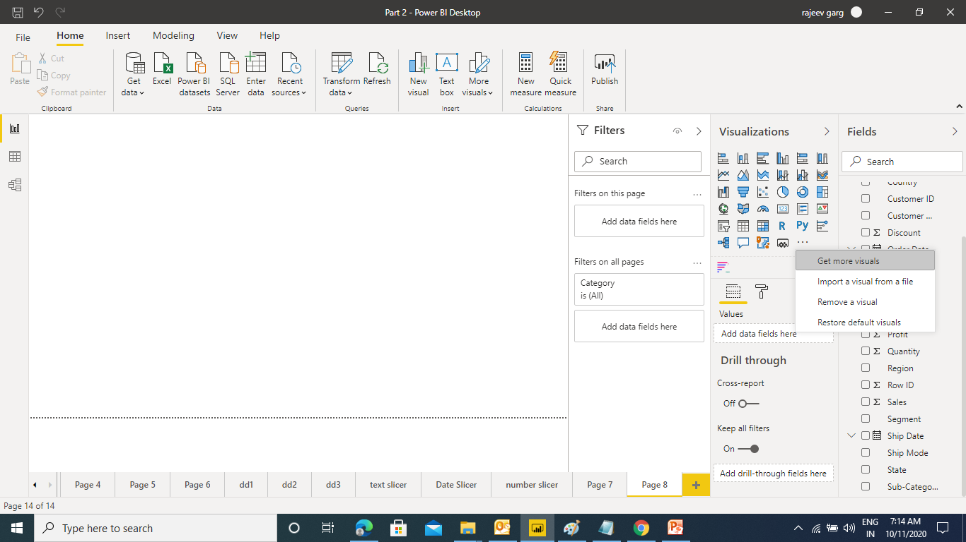
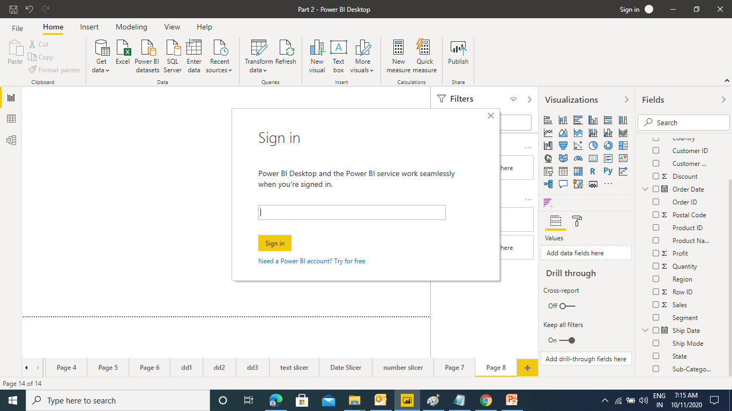
Advance Charts in Power BI
In Power Bi you can import advance charts as add-ins developed by other developers.
To add the charts you need to have Power Bi account which can be created using corporate / university email ID.

Slide 28
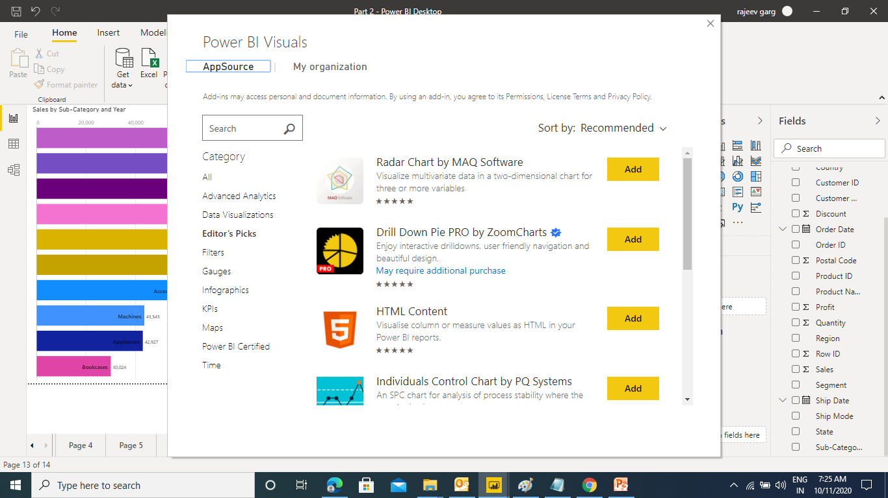
Advance Charts in Power BI
Once logged in to Power Bi you will be taken to App Store

Slide 29
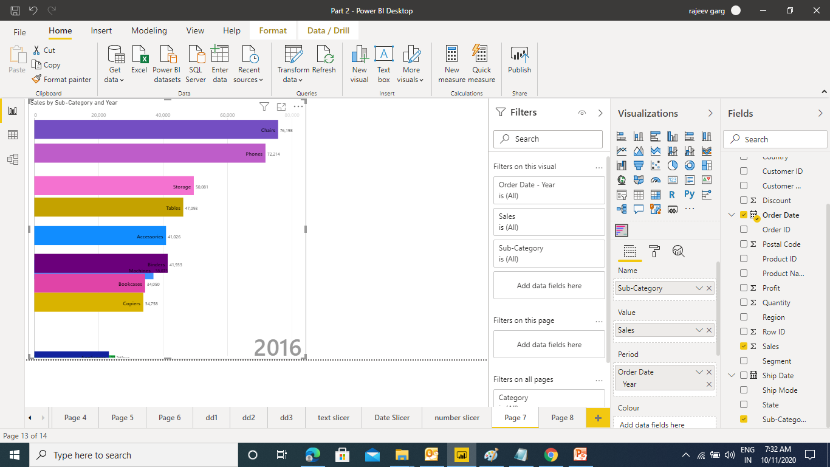
Advance Charts in Power BI
Animated Bar chart Race

